Slide 1

TITAN insurance A group assignment
GROUP 1 – CHN-BABI-JAN2017
Abishek | K S Suraj | Mithran | Suryaprakash | Santhosh

Slide 2
The Hypothesis
There are 2 Schemes, One is Old Scheme and Other is New Scheme. If the Average Sales of the Scheme is better than the old scheme, Firm will continue with New scheme, else status quo. [ There is a breakeven expected in 6 months to count for success ]
NULL HYPOTESIS – H₀ | Average Sales of Old Scheme is same as Average Sales of New Scheme i.e., µ₀ = µ₁
ALTERNATE HYPOTHESIS - H_{A} | Average Sales of New Scheme is greater than Average Sales of Old Scheme

Slide 3
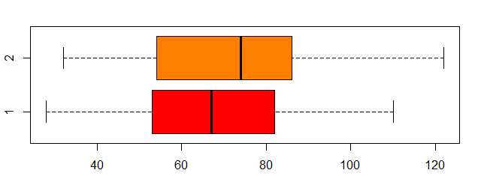
Data
Sales.Person | 1 | 2 | 3 | 4 | 5 | 6 | 7 | 8 | 9 | 10 | 11 | 12 | 13 | 14 | 15 | 16 | 17 | 18 | 19 | 20 | 21 | 22 | 23 | 24 | 25 | 26 | 27 | 28 | 29 | 30
Old.Scheme | 57 | 103 | 59 | 75 | 84 | 73 | 35 | 110 | 44 | 82 | 67 | 64 | 78 | 53 | 41 | 39 | 80 | 87 | 73 | 65 | 28 | 62 | 49 | 84 | 63 | 77 | 67 | 101 | 91 | 50
New.Scheme | 62 | 122 | 54 | 82 | 84 | 86 | 32 | 104 | 38 | 107 | 84 | 85 | 99 | 39 | 34 | 58 | 73 | 53 | 66 | 78 | 41 | 71 | 38 | 95 | 81 | 58 | 75 | 94 | 100 | 68
Exploratory Analysis
Box Plot
Old Scheme |  |  | New Schme
Mean | 68.03333333 |  | Mean | 72.03333333
Standard Error | 3.734733933 |  | Standard Error | 4.393172167
Median | 67 |  | Median | 74
Mode | 84 |  | Mode | 84
Standard Deviation | 20.45598021 |  | Standard Deviation | 24.06239495
Sample Variance | 418.4471264 |  | Sample Variance | 578.9988506
Kurtosis | -0.419684789 |  | Kurtosis | -0.76387692
Skewness | 0.040164666 |  | Skewness | -0.023559279
Range | 82 |  | Range | 90
Minimum | 28 |  | Minimum | 32
Maximum | 110 |  | Maximum | 122
Sum | 2041 |  | Sum | 2161
Count | 30 |  | Count | 30
Confidence Level(95.0%) | 7.638388545 |  | Confidence Level(95.0%) | 8.985045938
No Outliers
New Scheme is little Skewed towards right with in IQR

Slide 4
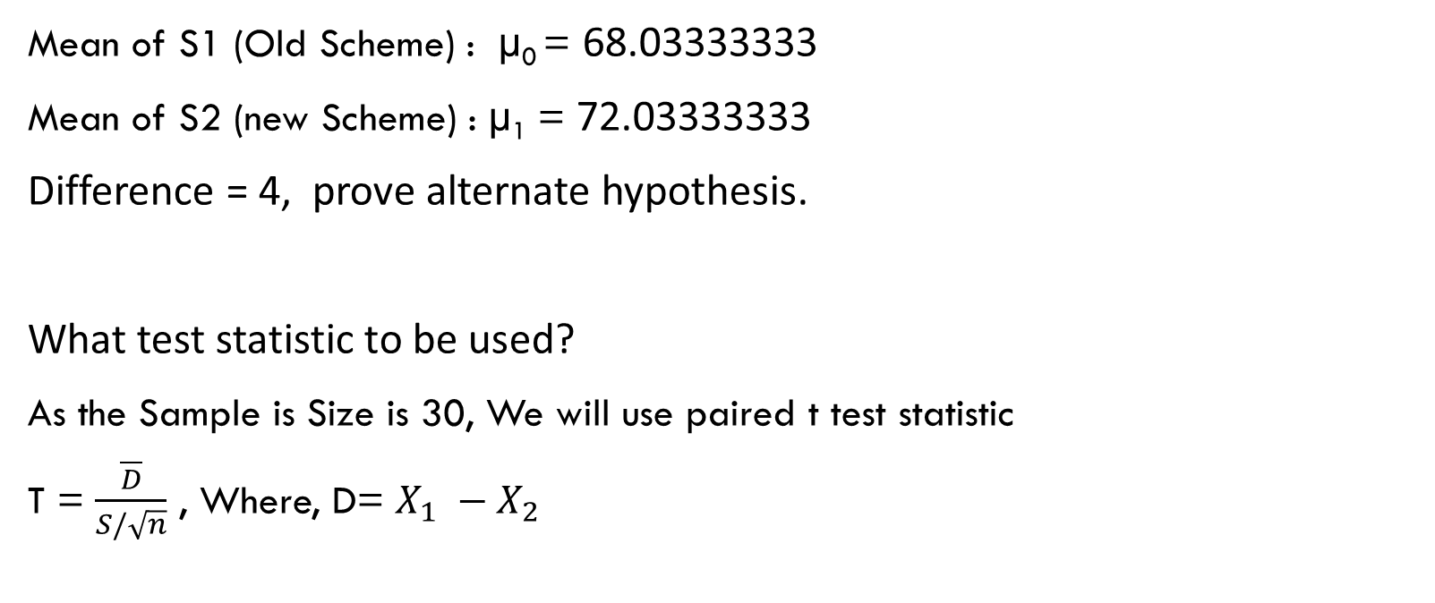
Identify the hypothesis and test statistic
Mean of S1 (Old Scheme) : µ₀ = 68.03333333
Mean of S2 (new Scheme) : µ₁ = 72.03333333
Difference = 4, prove alternate hypothesis.
What test statistic to be used?
As the Sample is Size is 30, We will use paired t test statistic
T = $\frac{\overline{D}}{S/\sqrt{n}}$ , Where, D= $X_{1} −X_{2}$

Slide 5

Question 1 – significant test
From the problem, we understand that, significance of the test depends on 2 sample data sets, old and new schemes. The question is to determine whether new scheme has significantly raised outputs. Significant levels is set as 5%, or Zstat as -1.64485.
$\overline{D}$ = $X_{1} −X_{2}$
$X_{1}$ = 68.03333333 | $X_{2}=\text{72.0333333}$ | $\overline{D}$ = 4
$S/\sqrt{n}$ = 2.571
T = -1.55591

Slide 6
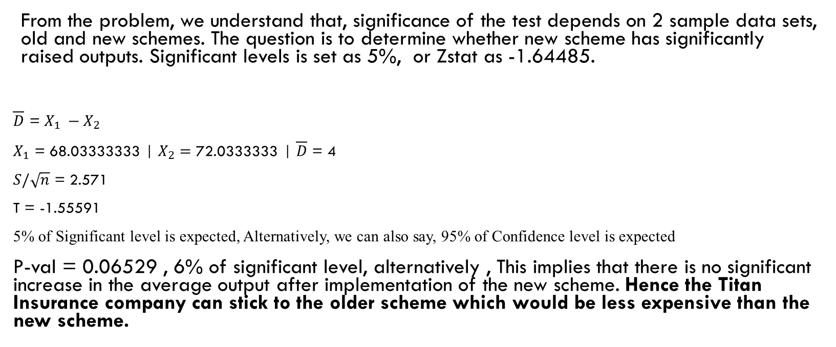
Question 1 & 2 – significant test
From the problem, we understand that, significance of the test depends on 2 sample data sets, old and new schemes. The question is to determine whether new scheme has significantly raised outputs. Significant levels is set as 5%, or Zstat as -1.64485.
$\overline{D}$ = $X_{1} −X_{2}$
$X_{1}$ = 68.03333333 | $X_{2}=\text{72.0333333}$ | $\overline{D}$ = 4
$S/\sqrt{n}$ = 2.571
T = -1.55591
5% of Significant level is expected, Alternatively, we can also say, 95% of Confidence level is expected
P-val = 0.06529 , 6% of significant level, alternatively , This implies that there is no significant increase in the average output after implementation of the new scheme. Hence the Titan Insurance company can stick to the older scheme which would be less expensive than the new scheme.

Slide 7
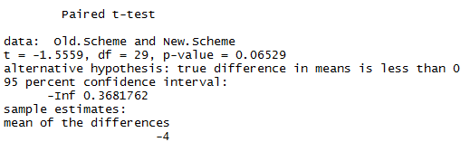
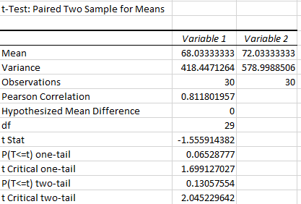
Question 1 & 2 – significant test – R & Excel proof
R
Excel

Slide 8
Question 3 - Reservations
Taking advantage if Central Limit Theorem, we Assume Population is Distributed Normally.
Coefficient Variable of New Scheme is 33% versus old Scheme which is 30%, that says, More risk is involved in New Scheme
Both the samples are random continuous Variable
Observations are mutually independent to each other.
Population Size or Population mean is not given.
Looking at the box-plot, we can infer there are no outliers.
New Scheme is little Skewed towards right with in IQR

Slide 9
Question - 4
Suppose it has been calculated that in order for Titan to break even, the average output must increase by £5000. If this figure is alternative hypothesis, what is:
(i) The probability of a type 1 error?
(ii) The probability of a type 2 error?
(iii)The power of the test?

Slide 10
Question – 4 : The probability of a type 1 error
From the previous discussion and generally accepted criteria for Type I error being 5%, here also it is same 5%

Slide 11

Question – 4 : The probability of a type 2 error & Power of Test
To Find Power of Test
Step 1 : Find the Standard Deviation of Samples
S1 – Standard Deviation of Old Scheme = 20.46
S2 - Standard Deviation of New Scheme = 24.06
R

Slide 12


Question – 4 : The probability of a type 2 error & Power of Test
Step 2 : Calculate Combined Standard Deviation or Pooled Standard Deviation
$Pooled Standard Deviation= \sqrt{\left(\left(S_{1}^{2}+ S_{2}^{2}\right)/2\right)}$
R

Slide 13
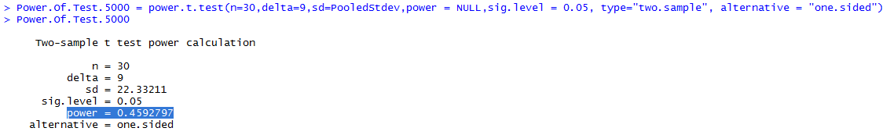
Question – 4 : The probability of a type 2 error & Power of Test
Step 3 : To Calculate β (Power)
Stated : Average mean has to be increased by $5000 in the new scheme to achieve breakeven, So $5000 needs to be added to $4000(mean diff of existing sample)
R

Slide 14
Question – 4 : The probability of a type 2 error & Power of Test
To Find Type II Error (β)
Power (POT) = 0.4592797
1 - 0.4592797 = 0.5407203
β = 0.5407203
Actually,
Power Of Test (POT) = 1 - β
POT = 1 - β
1- β =POT
-β = POT-1
β = -POT+1
β = 1-POT

Slide 15
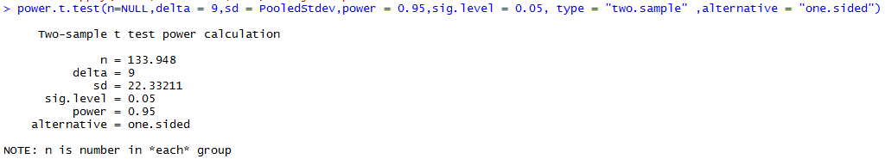
Question – 5 : SAMPLE SIZE that MAKEs THE PROBABILITIES OF TYPE I AND TYPE II ERRORS EQUAL
R Code
We Need 133.948, or 134 samples approximately that will make the probabilities of TYPE I error and TYPE II errors Equal

Slide 16
Thank you

